Slide 1
THIRD GRADE WELCOMES YOU BACK TO SCHOOL !!!
2019-2020

Slide 2
Mrs. Keebaugh’s
Class
Mrs. Hand’s Class
Mrs. Trujillo’s Class

Slide 3
MEET YOUR TEACHERS

Slide 4
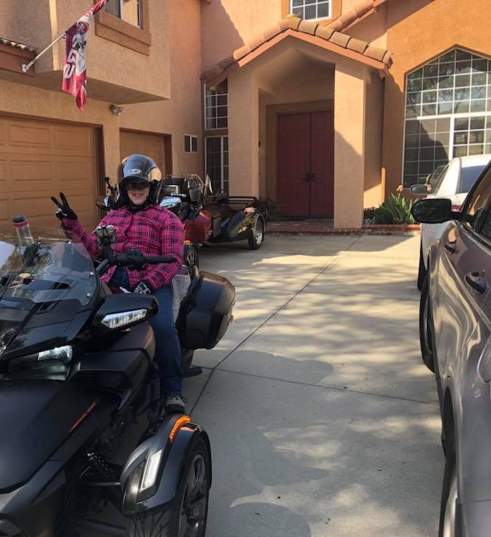
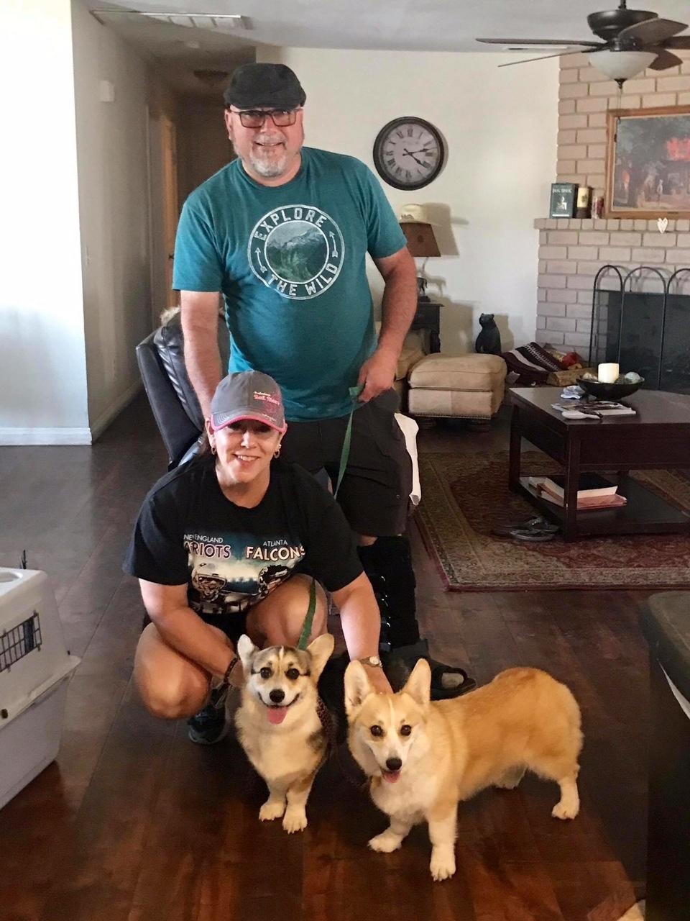
MRS. HAND

Slide 5
Mrs. Hand
Has been married 4 1/2 years
Lives in Chino
Has 30 years of teaching experience
Has taught grades 2 through 6 and intervention
Loves dogs, horses, and chocolate
Will teach Science and Social Studies this year

Slide 6
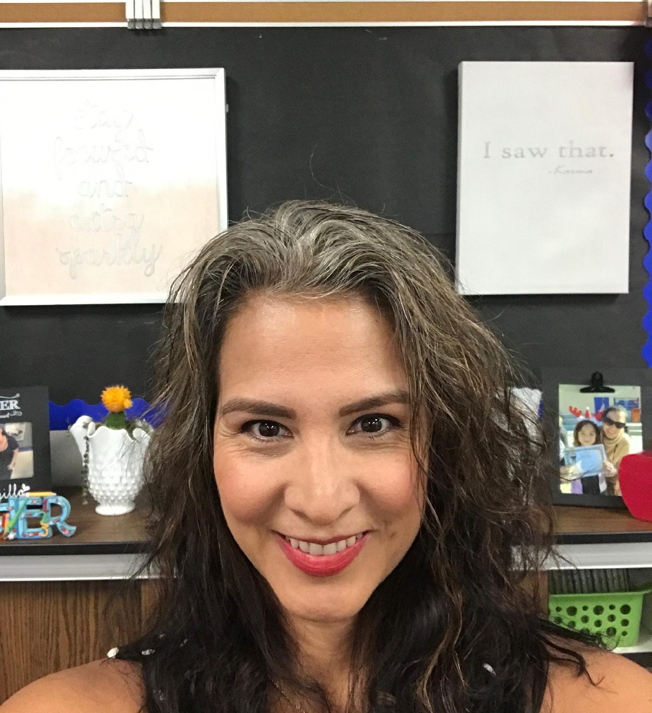
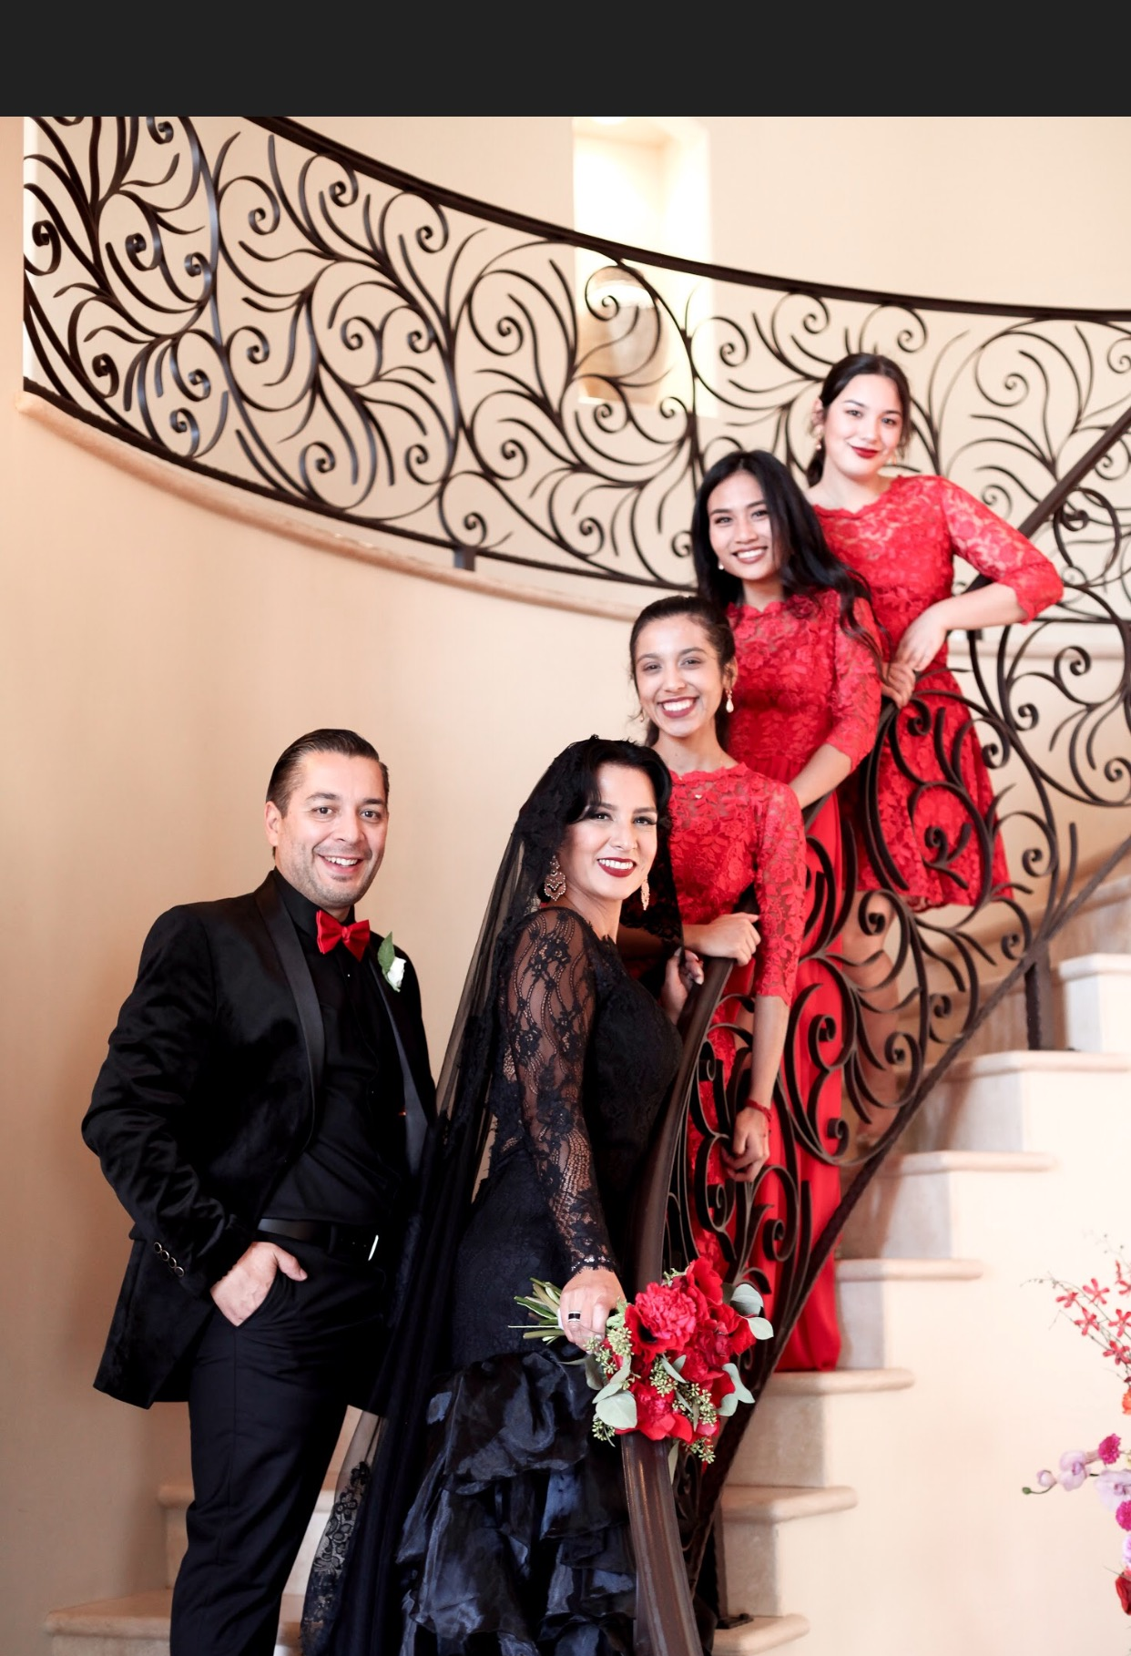
MRS. TRUJILLO

Slide 7
MRS. TRUJILLO
HAS BEEN MARRIED 2 YEARS
LIVES IN ONTARIO RANCH
HAS TAUGHT FOR 23 YEARS
IS BEGINNING HER 7TH YEAR AT BRIGGS
LOVES STARBUCKS, WOLVERINE, HER PET TORTOISES, BUNNY AND KITTY
WILL TEACH LANGUAGE ARTS THIS YEAR

Slide 8
MRS. KEEBAUGH

Slide 9
Mrs. Keebaugh
Lives with her husband, dogs, and cats in Chino Hills
Has 29 years of teaching experience
Has taught grades K,1, 3, 5, 6, 7 (math), 9-12 (math)
Loves the mountains, taking road trips to visit historical sites and my adult children, and enjoys too many hobbies to list.
Will teach math this year.

Slide 10
Third Grade Schedule 2019-2020
TIME/DAY | MONDAY | TUESDAY | WEDNESDAY | THURSDAY | FRIDAY
8:15-9:05 | Rally Homeroom Attendance Lunch Count Morning Activity Spelling Pretest | Homeroom Attendance Lunch Count Morning Activity | 8:15-8:50 Art/Enrichment | Homeroom Attendance Lunch Count Morning Activity | Homeroom Attendance Lunch Count Morning Activity Spelling Test
 |  |  | 8:55-9:40 Block 1 9:10 - 9:40 Music Hand
 |  | 8:35-9:05 Music Trujillo |  | 8:35-9:05 Music Keebaugh
 |  |  | 9:40-10:10 LUNCH
9:05-10:05 | Block 1 | Block 1 |  | Block 1 | Block 1
 |  |  | 10:10-10:50 Block 2
10:05-10:18 | RECESS | RECESS |  | RECESS | RECESS
10:20-11:25 | Block 2 | Block 2 | 10:50-11:30 Block 3 | Block 2 | Block 2
11:30-12:10 | LUNCH | LUNCH |  | LUNCH | LUNCH
 |  |  | 11:35-11:45 Closing
12:20-1:20 | Block 3 | Block 3 |  | Block 3 | Block 3
1:20-1:33 | RECESS | RECESS |  | RECESS | RECESS
1:33-2:05 | *Pullout Intervention/RSP Panther Time | *Pullout Intervention/RSP Panther Time |  | *Pullout Intervention/RSP Panther Time | *Pullout Intervention/RSP Panther Time
2:15-2:55 | Hand&Trujillo PE Keebaugh LIB/Closing (2:35-2:55) | Keebaugh&Trujillo PE Hand LIB/Closing (2:35-2:55) |  | Keebaugh&Hand PE Trujillo LIB/Closing (2:35-2:55) | CLOSING All 3rd PE

Slide 11
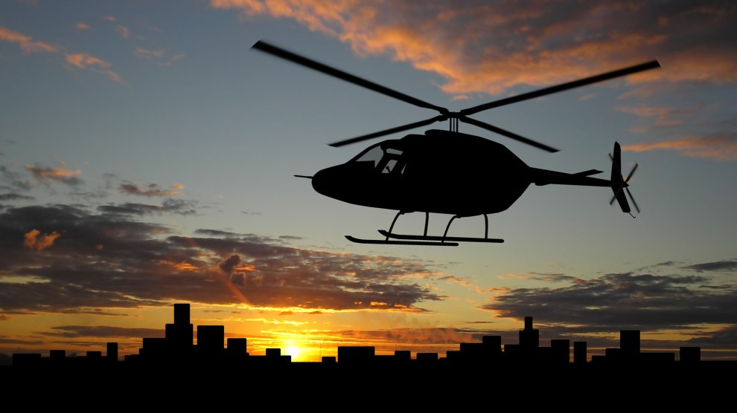
Life and College Readiness
Responsibility and Accountability
- students come in with all materials
needed to learn
- student governed class
- leadership (Elections held at the end of
each month. The requirements must be
met.)
Independent Organization and Systems
- desks
- binders are cleaned out weekly and
brought daily. Binders are checked each
Monday.

Slide 12
Collaboration
- norms are followed
- students support each other, so no
student is left behind
- students challenge each other
-participation is not optional

Slide 13
Essential Question:
What is you child’s mindset
towards school?

Slide 14
Habits of Success
Good Attendance
- Schedule appointments after school.
Homework Completion and Policy
- Three (3) days notice must be given if work is wanted for vacation or a weeks
notice for Independent study.
- It is the students’ responsibility to ask for makeup work and to schedule retests
(recess is not an option).
- Three(3) days is given to turn in work and reschedule tests after students’ return.
Zeros will be given on tests after that.
- If a student leaves early, work will not be given until the next day.
- Homework is checked each morning.
- Three (3) homework assignments missed in a trimester results in a parent-teacher
meeting.

Slide 15
Grading Policy
With standards-based grading, students are
able to practice their mastery of standards
without concern that imperfect practice work
will drag down their grades.
•Standard Based Report Card: Work Graded
with 4 point rubric (work stamped) and
multiple measures.
•Work Habits: class work, homework,
agenda, group work, participation (DOJO),
quality of work
•Responsibility and Integrity: behavior,
organization, work completion
•21st Century Skills: Collaboration and group
work

Slide 16
Teacher – Parent Communication
Agenda-This will be our daily communication. Students document homework, behavior, reading and any announcements. Please send your child with $10 and they will be given their agenda. This must be the first item in their binder. It is checked daily for a parent signature.
Aeries Parent Portal - Go to our school website and register. There are instructions on how to sign up. Your child’s grades will be posted online when our gradebooks are set up.
Classroom Dojo - This will help you monitor your student’s behavior and participation in class. I will be using this for a participation and behavior grade. This is a phone app.
- Friday Dojo Graph Goal
- Check the Dojo for behavior progress. Discuss how they can do better and set a goal.
Friday folder - Please check it every day for notes and Friday for completed work. This will help you see your child’s progress.

Slide 17
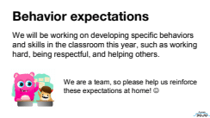

Slide 18
WE WILL BE USING CLASSDOJO TO ENCOURAGE THESE BEHAVIORS AND SKILLS, AND TO STAY IN TOUCH!

Slide 19
OUR CONSTITUTION
I. Be Respectful
II. Be A Team Player
III. Be Responsible
IV. Be Safe
V. Do Your Best
VI. Be Engaged in Learning

Slide 20
Students are allowed to use the restroom
(bathroom pass can be used once a week)
All behavior, work habits and participation recorded on the Dojo

Slide 21
PARENT VOLUNTEERS NEEDED
If you help, we can
plan and teach.
If you help, we can plan and teach.

Slide 22
Parent Volunteers Needed for Each Room
Room Parents – 2
Fluency – 2
Book Orders – 1 for all of 3rd grade
Prep – 2
Picture Person – 2 or more
Monday Binder Checker – 1 to 2
Grader – 1

Slide 23
CLASS NEEDS
Tissue
Baby Wipes
Clorox Wipes
Copy Paper
Yellow Copy Paper
Pencils
Page Protectors

Slide 24
PARENT-TEACHER CONFERENCE SIGNUPS

Slide 25
Reminders
Tennis shoes should be worn on PE days.
Bring a towel with a name or pattern for PE
Only sports-top water bottles are allowed at desks.
Label everything with the student’s name.
Provide healthy snacks for recess.

